Slide 1
Gene regulation
Chapter
18

Slide 2
Bacterial reproduction
No meiosis occurs and there is no fertilization
Sometimes bacteria reproduce via cloning or asexual means – makes exact copies
But if bacterial DNA is changed, there are four ways: mutation, transformation, transduction, or conjugation

Slide 3
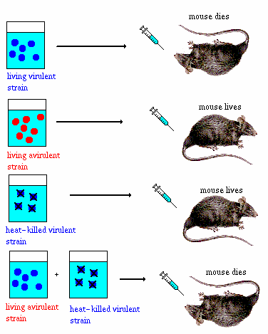
Bacterial Transformation
The alteration of a bacterial cell’s genotype and phenotype by the uptake of naked, foreign DNA from the surrounding environment

Slide 4
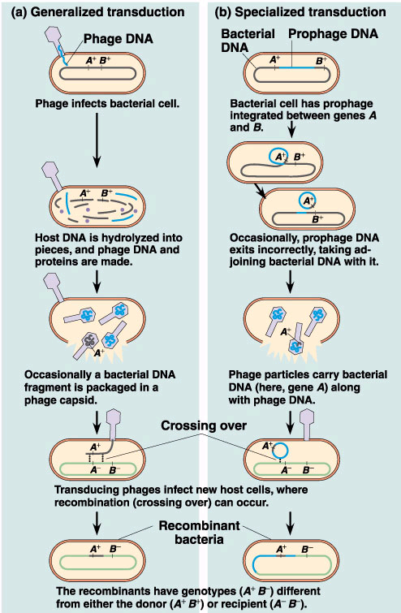
Bacterial Transduction
Phages carry bacterial genes from one host cell to another

Slide 5
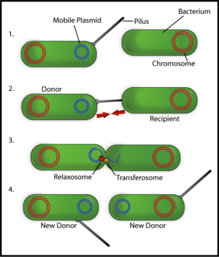
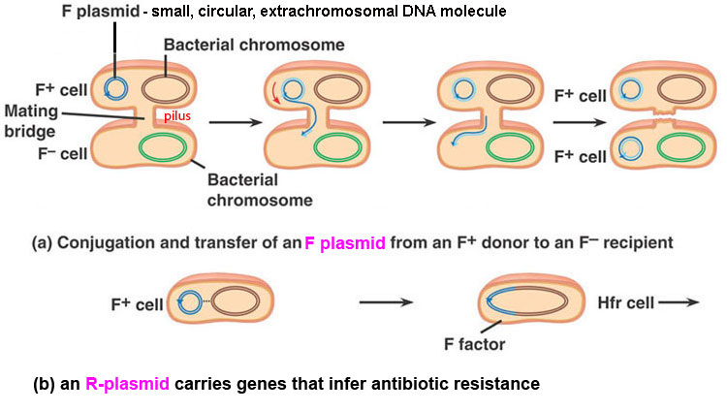
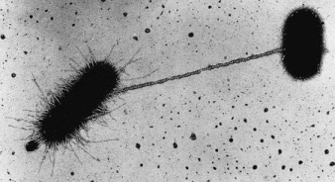
Bacterial Conjugation
Direct transfer of genetic material between two bacterial cells that temporarily join.

Slide 6
GENE CONTROL
Why is it important to be able to control the expression of genes?
Regulatory Proteins
Intervene before, during & after gene transcription
Negative Control: “repressors”
Slows activity – typical of anabolic pathways
Positive Control: “activators”
Promote or enhance activity
Examples of positive control:
Promotors-signal start of a gene
Enhancers-binding sites for activator proteins

Slide 7
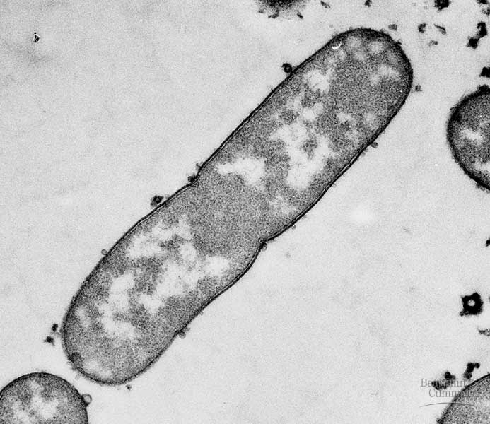
E. coli (bacteria)

Slide 8
Gene Control in E. coli
Genes are typically grouped together in succession
Promoter Region:
RNA polymerase must attach here to start transcription
Operator Region:
Near promoter region, site for controlling transcription
Operon:
Promoter, operator, and associated genes
Regulatory Gene:
Codes for the repressor protein
Repressor:
Blocks transcription by binding to the operator region (ex. tryptophan)
3 Important genes in lac operon: (no need to memorize these)
Lac Z → ß-galactosidase
Lac Y → Permease
Lac A → Transacetylase

Slide 9
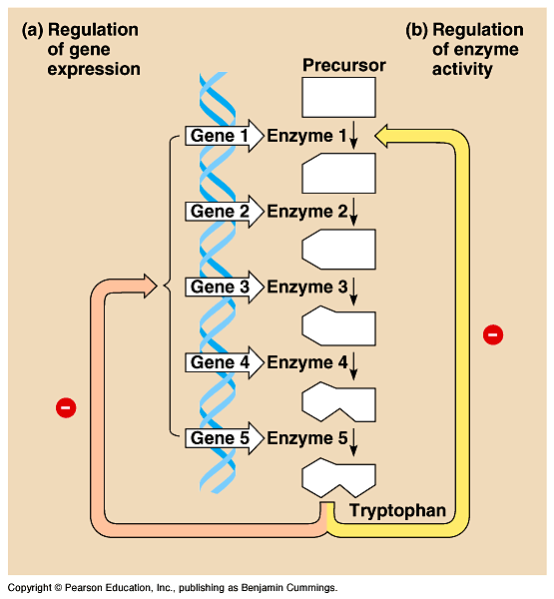
Figure 18.2 Regulation of a metabolic pathway

Slide 10
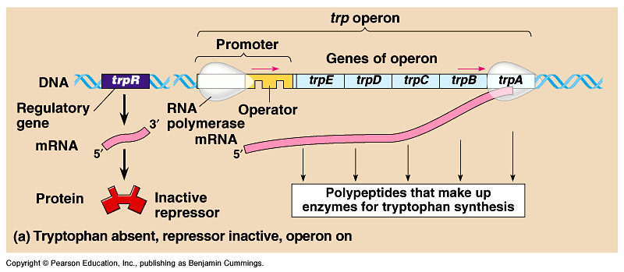
Figure 18.3a The trp operon: regulated synthesis of repressible enzymes
Repressible operon b/c transcription is usually on but can be inhibited if tryptophan binds to a regulatory protein

Slide 11
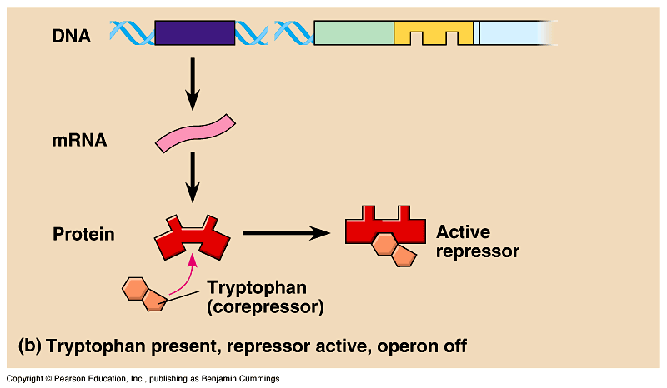
Figure 18.3b The trp operon: regulated synthesis of repressible enzymes (Layer 1)

Slide 12
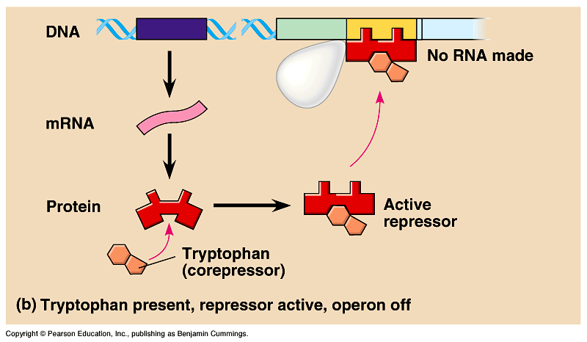
Figure 18.3b The trp operon: regulated synthesis of repressible enzymes (Layer 2)

Slide 13
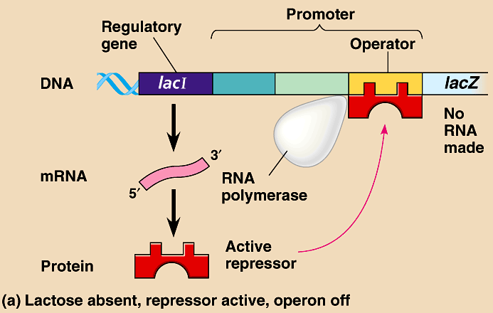
Inducible operon is usually off but can be induced when a specific molecule interacts with a regulatory protein (lac operon)

Slide 14
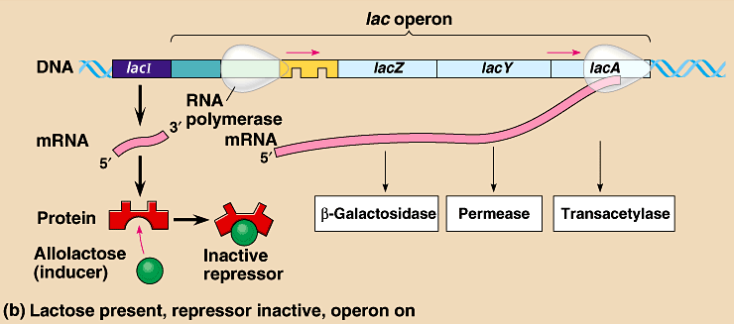

Slide 15
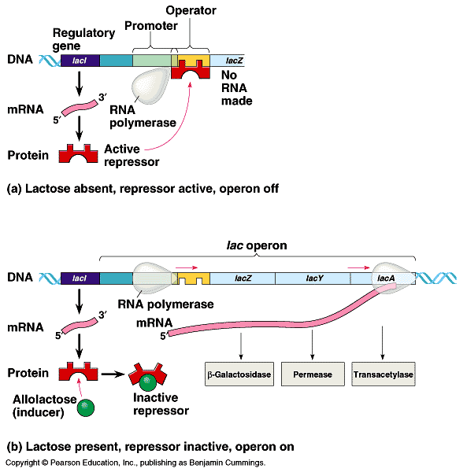

Slide 16
Summary
Inducible enzymes – their synthesis is induced by a chemical signal – normally “off” (lactose pathway). These enzymes are typical of catabolic pathways (saving energy/resources and not producing proteins that are not currently necessary).
Repressible enzymes – suspend production of an end product when it is in sufficient quantity – normally “on” (tryptophan pathway). These enzymes are typical of anabolic pathways (saving energy by not producing products that are already present).
Both are examples of negative control of genes, because the operons are switched off by the active form of the repressor protein

Slide 17
Eukaryotic gene expression is regulated at many stages
All organisms must regulate which genes are expressed at any given time
In multicellular organisms regulation of gene expression is essential for cell specialization
© 2011 Pearson Education, Inc.

Slide 18
Differential Gene Expression
Almost all the cells in an organism are genetically identical
Differences between cell types result from differential gene expression, the expression of different genes by cells with the same genome
Abnormalities in gene expression can lead to diseases including cancer
Gene expression is regulated at many stages
© 2011 Pearson Education, Inc.

Slide 19
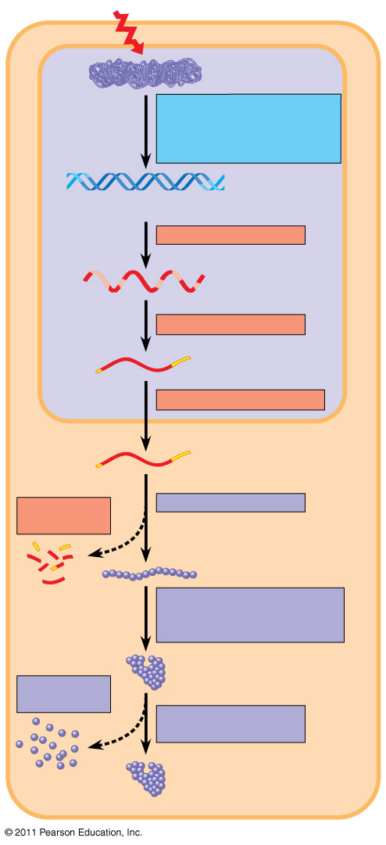
Figure 18.6
Signal
NUCLEUS
Chromatin
Chromatin modification: DNA unpacking involving histone acetylation and DNA demethylation
DNA
Gene available for transcription
Gene
Transcription
RNA
Exon
Primary transcript
Intron
RNA processing
Tail
Cap
mRNA in nucleus
Transport to cytoplasm
CYTOPLASM
mRNA in cytoplasm
Degradation of mRNA
Translation
Polypeptide
Protein processing, such as cleavage and chemical modification
Degradation of protein
Active protein
Transport to cellular destination
Cellular function (such as enzymatic activity, structural support)
Notes:
Figure 18.6 Stages in gene expression that can be regulated in eukaryotic cells.

Slide 20
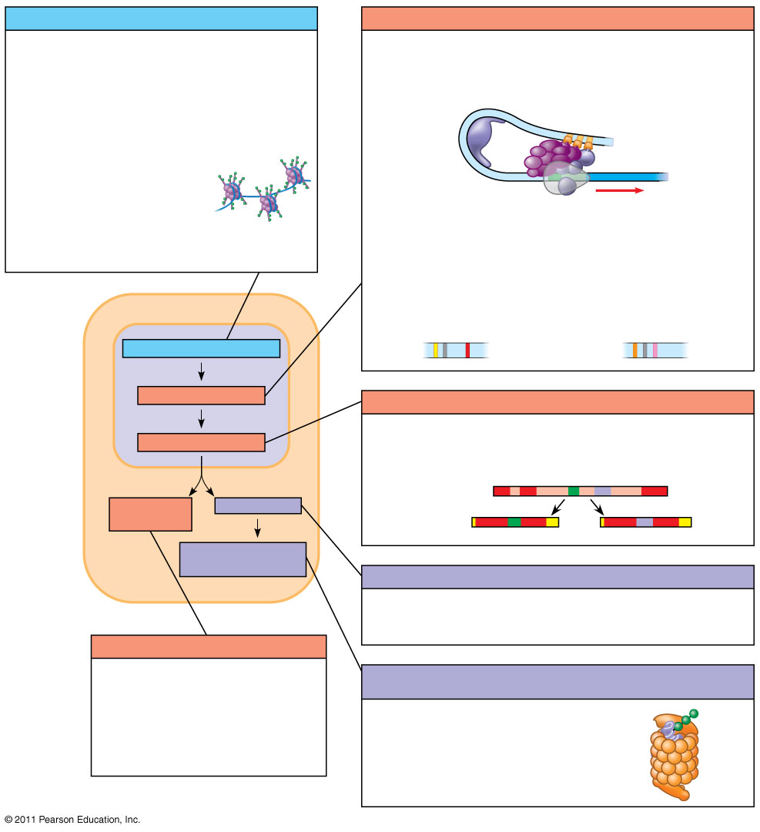
Figure 18.UN04
Chromatin modification
Transcription
• Genes in highly compacted chromatin are generally not transcribed.
• Regulation of transcription initiation: DNA control elements in enhancers bind specific transcription factors.
• Histone acetylation seems to loosen chromatin structure, enhancing transcription.
Bending of the DNA enables activators to contact proteins at the promoter, initiating transcription.
• DNA methylation generally reduces transcription.
• Coordinate regulation:
Enhancer for liver-specific genes
Enhancer for lens-specific genes
Chromatin modification
Transcription
RNA processing
RNA processing
• Alternative RNA splicing:
Primary RNA transcript
mRNA degradation
Translation
mRNA
or
Protein processing and degradation
Translation
• Initiation of translation can be controlled via regulation of initiation factors.
mRNA degradation
• Each mRNA has a characteristic life span, determined in part by sequences in the 5′ and 3′ UTRs.
Protein processing and degradation
• Protein processing and degradation by proteasomes are subject to regulation.
Notes:
Figure 18.UN04 Summary figure, Concept 18.2

Slide 21
Effects on mRNAs by MicroRNAs and Small Interfering RNAs
MicroRNAs (miRNAs) are small single-stranded RNA molecules that can bind to mRNA
These can degrade mRNA or block its translation
© 2011 Pearson Education, Inc.

Slide 22
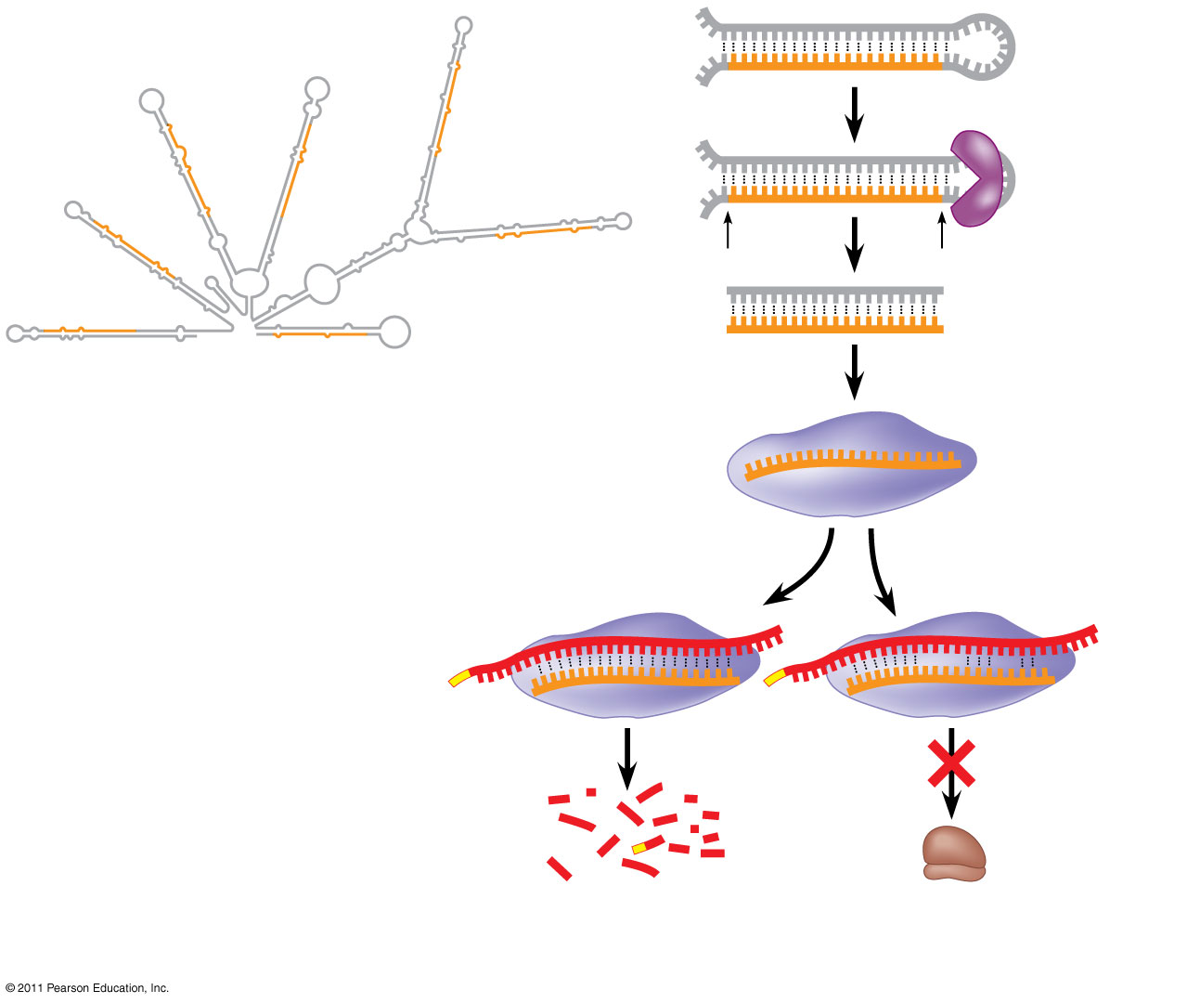
Figure 18.15
Hairpin
miRNA
Hydrogen bond
Dicer
5′
3′
(a) Primary miRNA transcript
miRNA
miRNA- protein complex
mRNA degraded
Translation blocked
(b) Generation and function of miRNAs
Notes:
Figure 18.15 Regulation of gene expression by miRNAs.

Slide 23
The phenomenon of inhibition of gene expression by RNA molecules is called RNA interference (RNAi)
RNAi is caused by small interfering RNAs (siRNAs)
siRNAs and miRNAs are similar but form from different RNA precursors – both can associate with the same proteins, resulting in similar results.
© 2011 Pearson Education, Inc.

Slide 24
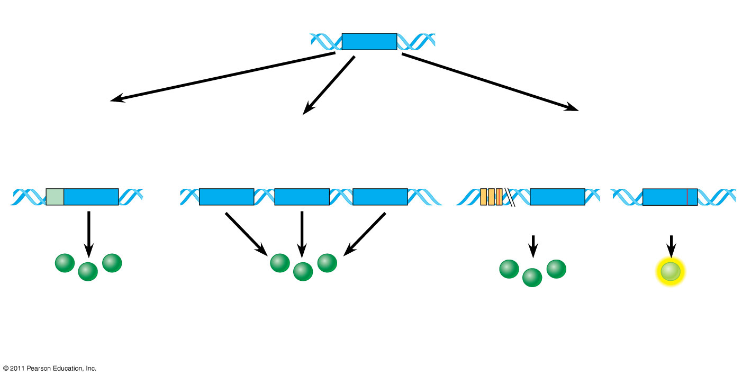
Genetic changes that can turn proto-oncogenes into oncogenes
Proto-oncogene
DNA
Translocation or transposition: gene moved to new locus, under new controls
Gene amplification: multiple copies of the gene
Point mutation:
within a control element
within the gene
New promoter
Oncogene
Oncogene
Normal growth- stimulating protein in excess
Normal growth-stimulating protein in excess
Normal growth- stimulating protein in excess
Hyperactive or degradation- resistant protein
Notes:
Figure 18.23 Genetic changes that can turn proto-oncogenes into oncogenes.

Slide 25
Oncogenes and the Cell Cycle
Proto-oncogene vs. oncogenes
Ras gene makes ras protein – a class of small protein called GTPase involved in cellular signal transduction – normally “off” without proper growth factor
Mutations in Ras gene keep signaling active, resulting in overactive cell growth and division
30% of all human cancers have Ras mutations and inhibitors are being studied

Slide 26
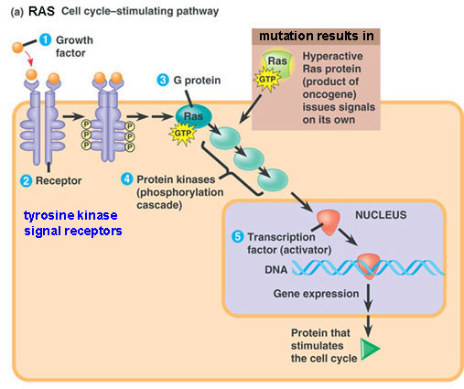

Slide 27
The p53 gene codes for a tumor suppressor protein
Anti-cancer functions, including inhibiting cell cycle at the G1/S checkpoint if DNA is damaged and can be repaired
Can initiate apoptosis if DNA cannot be repaired
Mutation(s) in p53 can allow damaged DNA to be passed to daughter cells during mitosis
HPV (human papilloma virus) can inactivate p53, leading to cervical cancer (e.g., Henrietta Lacks)

Slide 28
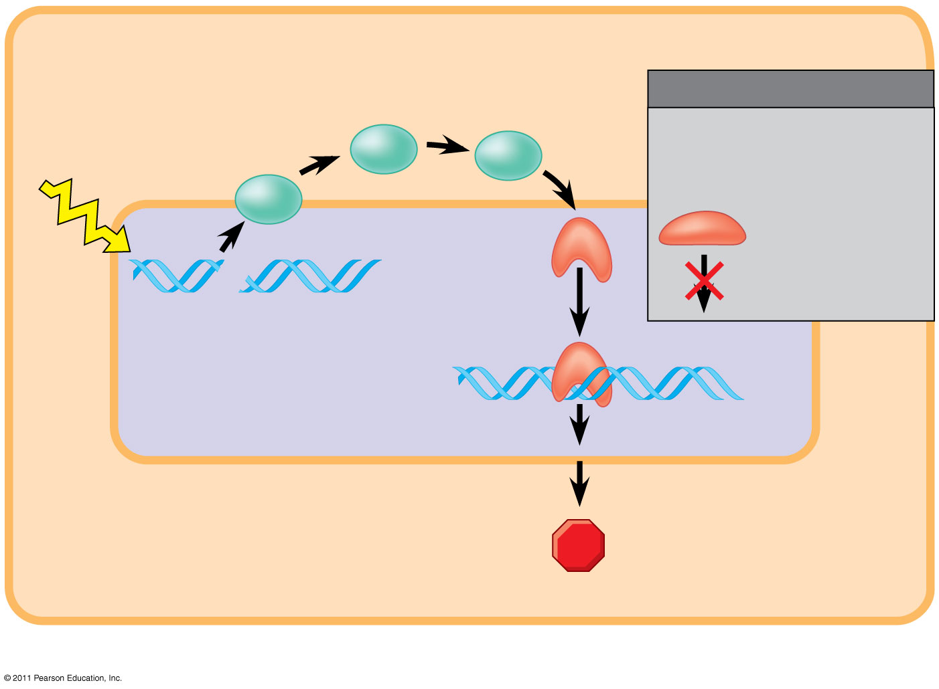
Figure 18.24b
2
Protein kinases
MUTATION
Defective or missing transcription factor, such as p53, cannot activate transcription.
UV light
3
Active form of p53
1
DNA damage in genome
DNA
Protein that inhibits the cell cycle
(b) Cell cycle–inhibiting pathway
Notes:
Figure 18.24 Signaling pathways that regulate cell division.

Slide 29
The Multistep Model of Cancer Development
Multiple mutations are generally needed for full-fledged cancer; thus the incidence increases with age
At the DNA level, a cancerous cell is usually characterized by at least one active oncogene and the mutation of several tumor-suppressor genes
© 2011 Pearson Education, Inc.

Slide 30
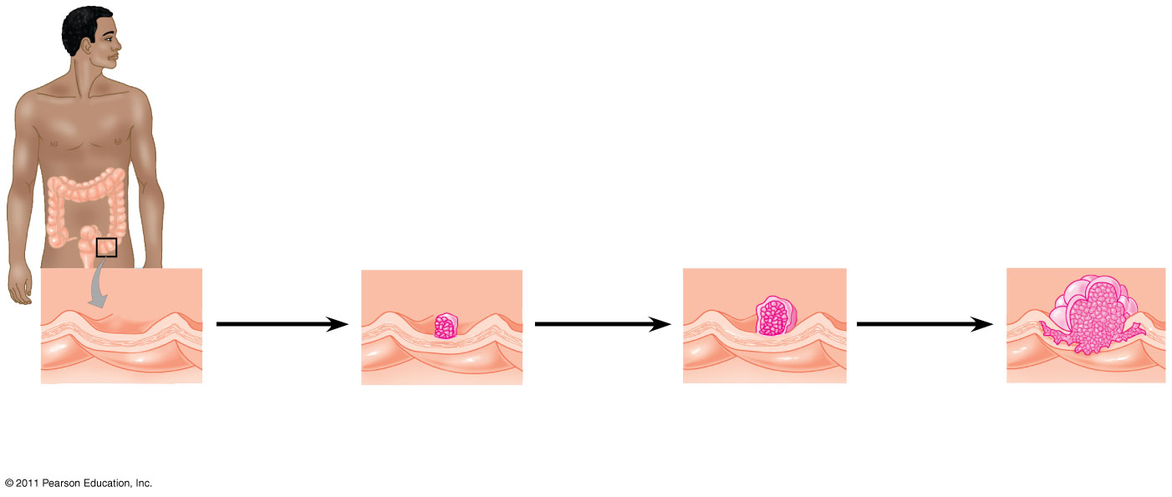
Figure 18.25
Colon
Chadwick Boseman
1
Loss of tumor- suppressor gene APC (or other)
4
Loss of tumor- suppressor gene p53
2
Activation of ras oncogene
3
5
Colon wall
Loss of tumor- suppressor gene DCC
Additional mutations
Normal colon epithelial cells
Small benign growth (polyp)
Larger benign growth (adenoma)
Malignant tumor (carcinoma)
Notes:
Figure 18.25 A multistep model for the development of colorectal cancer.

Slide 31
Inherited Predisposition and Other Factors Contributing to Cancer
Individuals can inherit oncogenes or mutant alleles of tumor-suppressor genes
Inherited mutations in the tumor-suppressor gene adenomatous polyposis coli are common in individuals with colorectal cancer
Mutations in the BRCA1 or BRCA2 gene are found in at least half of inherited breast cancers and ovarian cancers can be tested for using DNA sequencing to detect these mutations
© 2011 Pearson Education, Inc.

